Slide 1
Lecture 00 Data Communications
Basic Concepts
Data Communication and Layering

Slide 2
References
Books
Data Communications and Network, 6th, Behrouz A. FORIUZAN, McGraw-Hill
Data and Computer Communications, 9th, William Stallings, Pearson Education, Prentice Hall
Standards
IEEE 802, IETF RFC
Web sites
Wikipedia, etc

Slide 3
Contents
Data Communication
Definition
Data
Communication
Layering and Reference Model
ISO OSI 7-layer reference model
IEEE 802 Reference Model

Slide 4
Data Communication
Definition

Slide 5
Data Communications Definition
Data communications are the exchange of data between two devices via some form of transmission media
The Mathematical Theory of Communication
The fundamental problem of communication is that of reproducing at one point either exactly or approximately a message selected at another point.

Slide 6
Data Communication
Data

Slide 7
Data Communications Data and Data Standards
Digital Data
Text : Characters
Numbers
Audio
Voice (Speech) : Phone
Music
Sound
Image
Still Image (Photo, Drawings)
Moving Picture (Movie): real-time or non-real-time

Slide 8
Data Communications Data Standards : Characters
Unicode encoding model
character repertoire
the full set of abstract characters that a system supports
coded character set (CCS; U+0000 to U+10FFFF [17 planes])
a function that maps characters to code points
each code point represents one character
Basic Multilingual Plane (BMP; plane 0) : U+0000 to U+FFFF
CJK Unified Ideographs (4E00–9FFF)
character encoding form (CEF)
the mapping of code points to code units to facilitate storage in a system that represents numbers as bit sequences of fixed length
For example, a system that stores numeric information in 16-bit units can only directly represent code points 0 to 65,535 in each unit, but larger code points (say, 65,536 to 1.4 million) could be represented by using multiple 16-bit units
character encoding scheme (CES)
the mapping of code units to a sequence of octets to facilitate storage on an octet-based file system or transmission over an octet-based network
Unicode Transformation Format (UTF-8, UTF-16BE, UTF-32B)

Slide 9
Data Communications Data Standards : Numbers
Integers
Sign-magnitude, (sign:-(1),+(0))(magnitude)
(1)(11):(-3)..(1)(00):(-0),(0)(00):(+0)..(0)(11):(+3)
(-0)+(+0)=100+000=100 (-0), (-3)+(+3)=111+011=(1)010 (??)
One’s complement (-n..-0,+0..n)
100:(-3),101:(-2),110:(-1),111:(-1),000:(+0)..011:(+3))
(-0)+(+0)=111+000=111 (-0), (-3)+(+3)=100+011=111 (-0)
(-3)+(+1)=011+001 = 100 (-3)?? Overflow
(-1)+(+2)=110+010 = (1)(000)=>adding the carry bit: 000+(1) = 001
111:(0) 110:(-1) 101:(-2) 100:(-3)
Two’s complement (-n..-1,0..n-1)
100:(-4) 101:(-3),110:(-2),111:(-1),000:(0)..011:(+3))
(-1)+(+2)=111+010 =(1)001 (discarding the carry bit)

Slide 10
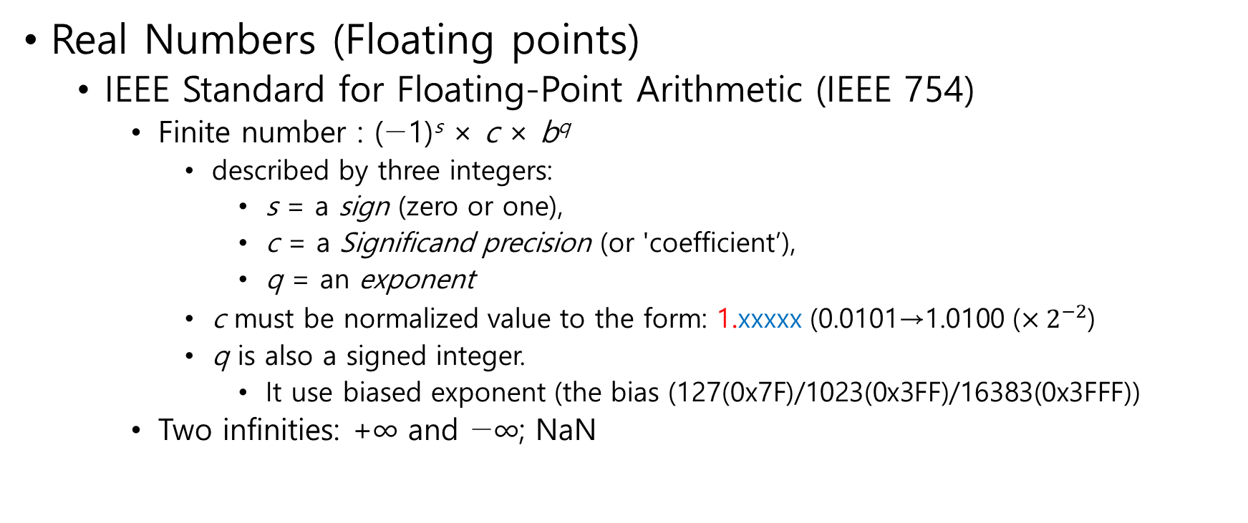
Data Communications Data Standards : Numbers
Real Numbers (Floating points)
IEEE Standard for Floating-Point Arithmetic (IEEE 754)
Finite number : (−1)^{s} × c × b^{q}
described by three integers:
s = a sign (zero or one),
c = a Significand precision (or 'coefficient’),
q = an exponent
c must be normalized value to the form: 1.xxxxx (0.0101→1.0100 ($×2^{−2}$)
q is also a signed integer.
It use biased exponent (the bias (127(0x7F)/1023(0x3FF)/16383(0x3FFF))
Two infinities: +∞ and −∞; NaN

Slide 11
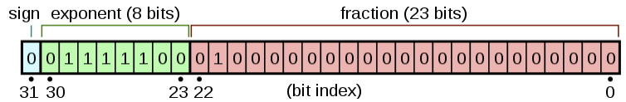

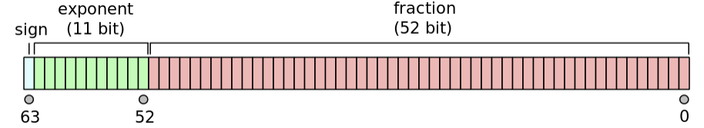
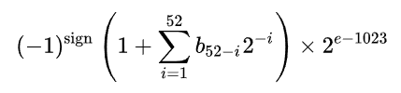
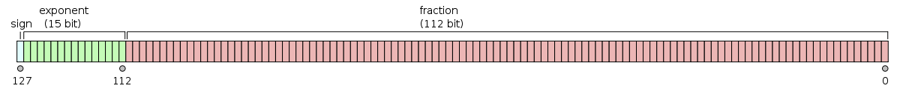
Data Communications Data Standards : Numbers
Real Numbers (Floating points)
IEEE Standard for Floating-Point Arithmetic (IEEE 754)
Single (4-octets)/Double (8-octets)/Quadruple (16-octets) precision

Slide 12

Data Communications Data Standards : Numbers
Real Numbers (Floating points)
IEEE Standard for Floating-Point Arithmetic (IEEE 754)
The two exponents are interpreted specially.
0x00(8bits)/0x000(11bits)/0x0000(15bits):$±0$
$±1×0.fraction×2^{e−bias}$. ($±1×1.fraction×2^{e−bias}$)
0xFF(8bits)/0x7FF(11bits)/0x7FFF(15bits):NaN($±\text{∞}$)

Slide 13
Data Communications Data Standards : Image
Image file formats
Raster graphics or bitmap image :
the data describes the characteristics of each individual pixel
JPEG(Joint Photographic Experts Group)
GIF (Graphics Interchange Format)
PNG (Portable Network Graphics)
open-source alternative to GIF
Vector formats :
a geometric description which can be rendered smoothly at any desired display size
SVG (Scalable Vector Graphics)
an open standard by the World Wide Web Consortium

Slide 14
Data Communications Data Standards : Video
Moving Picture Experts Group (MPEG)
a working group of ISO/IEC with the mission to develop standards for coded representation of digital audio and video and related data
MPEG-2 : Transport, video and audio standards for broadcast-quality television
MPEG-4 Part 2 (MPEG-4 Visual) : a video compression format
DivX, Xvid and Nero Digital
MPEG-4 Part 3 (MPEG-4 Audio) : audio coding methods
Speech coding – HVXC (Harmonic Vector eXcitation Coding)
Speech coding – CELP (Code Excited Linear Prediction)
General Audio Coding (GA) - Advanced Audio Coding (AAC)
MPEG-4 Part 10, Advanced Video Coding (MPEG-4 AVC) : a block-oriented motion-compensation-based video compression standard

Slide 15
Data Communications Data Description Standards : Audio
Non-compression
Linear pulse-code modulation (LPCM, PCM)
Pulse-density modulation (PDM)
Lossless compression
Free Lossless Audio Codec (FLAC)
Apple Lossless Audio Codec (ALAC)
Lossy compression
Discrete cosine transform (DCT)
Adaptive Multi-Rate audio codec
an audio compression format optimized for speech coding
The standard speech codec by 3GPP

Slide 16
Data Communications Data Description Standards : Media Type
Media type (email/MIME, HTTP)
(RFC2046) Multipurpose Internet Mail Extensions (MIME) Part Two: Media Types
(RFC2045) Multipurpose Internet Mail Extensions (MIME) Part One: Format of Internet Message Bodies
A two-part identifier for file formats and format contents transmitted on the Internet

Slide 17
Data Communications Data Description Standards : Media Type
Media type (email/MIME, HTTP)
Top-level type name / subtype name [ ; parameters ]
text/plain; charset=UTF-8
audio/mpeg
image/png
image/jpeg
The currently registered top-level type names are:
application, audio, example, font, image, message, model,
multipart, text, video.

Slide 18
Data Communications Data Description Standards : AVP
Audio video profile
RTP audio/video profile (RTP/AVP)
It specifies a mapping of specific audio and video codecs and their sampling rates to RTP payload types and clock rates, and how to encode each data format as an RTP data payload, as well as specifying how to describe these mappings using Session Description Protocol (SDP)
(RFC3550) RTP: A Transport Protocol for Real-Time Applications
the real-time transport protocol (RTP)
the RTP control protocol (RTCP)
(RFC3551) RTP Profile for Audio and Video Conferences with Minimal Control
(RFC4566) SDP: Session Description Protocol

Slide 19
Data Communication
Communication

Slide 20
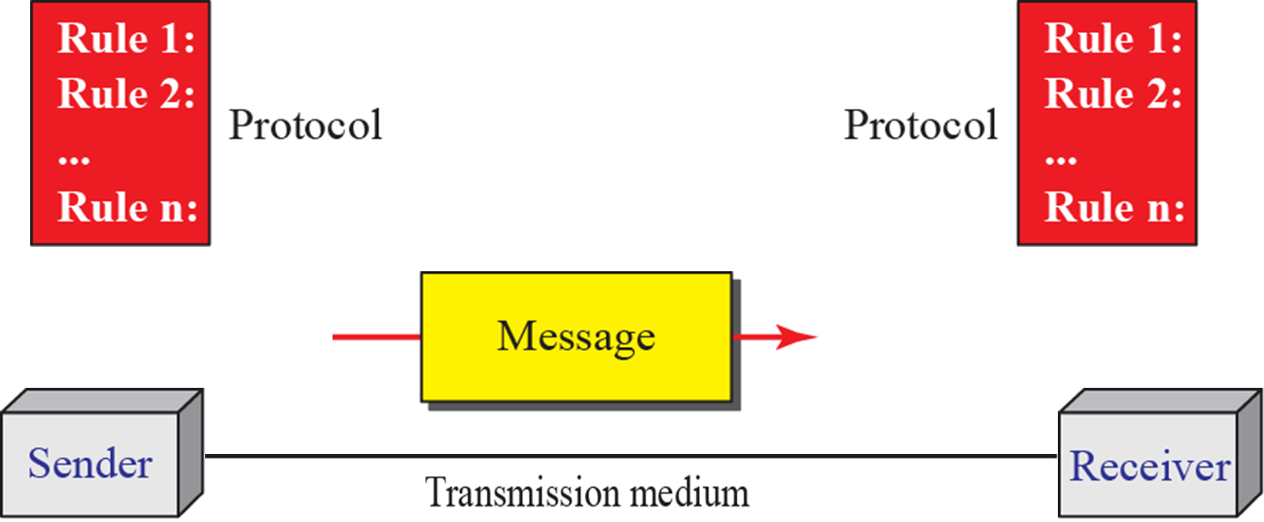
Data Communications Components
Five Components

Slide 21
Protocol : definition
A protocol defines the rules that both the sender and receiver, and all intermediate devices need to follow to be able to communicate effectively

Slide 22
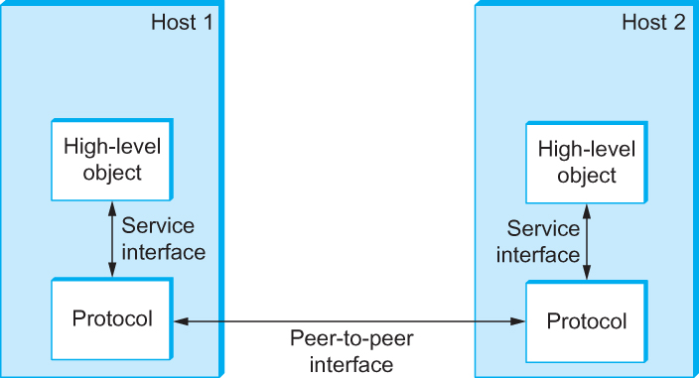
Protocol : the rules message format, order, actions
protocols define format, order of messages sent and received among network entities, and actions taken on messages transmission, receipt
(format, order)
(action)
The module implementing the protocol

Slide 23
Protocol : Sending a letter
Write the letter you want to send
Buy an envelope and a post stamp
Insert the letter into the envelope
Write the receiver’s name, address and postcode at the right bottom corner of the envelope
Write the sender’s name, address and postcode at the left upper corner of the envelope
Attach the post stamp to the envelope
Put the envelop into the postbox
Why do you stick this procedure?

Slide 24
Layering

Slide 25
Data Communications ISO OSI reference model
OSI (Open Systems Interconnection) reference model
A conceptual model that characterizes and standardizes the communication functions of a telecommunication or computing system without regard to their underlying internal structure and technology
International Organization for Standardization (ISO)
ISO/IEC 7498-1:1994 - Basic Reference Model

Slide 26
Data Communications ISO OSI reference model
Its goal is the interoperability of diverse communication systems with standard protocols
The model partitions a communication system into abstraction layers
The original version of the model defined seven layers

Slide 27
Data Communications Principles of protocol layering
Two principles of protocol layering
The two objects under each layer at both sites should be identical
If we want bidirectional communication, we need to make each layer so that it can perform two opposite tasks, one in each direction
Transmitter (Tx)
Receiver (Rx)

Slide 28
Data Communications N Layering
At each level N, two entities at the communicating devices (layer N peers) exchange protocol data units (PDUs) by means of a layer N protocol
[Layer N+1 PDU]
Service Data Unit (SDU)
[Layer N-1 PDU]
Service Data Unit (SDU)
Layer N PDU
Layer N
Layer N
Each PDU contains a payload, called the service data unit (SDU), along with protocol-related headers or footers.
[Layer N PDU]
Service Data Unit (SDU)
[Layer N PDU]
Service Data Unit (SDU)
Layer N-1
Layer N-1 PDU
Layer N-1

Slide 29
Data Communications Layering : Sending a letter (example)
SDU : the letter
PDU : the envelop with the receiver & the sender information
Protocol related header (Names, addresses, postcodes)
Layer N : the sender, the receiver
Both can send letters and receive envelopes
Layer N protocol : rules for writing the information of the receiver and the sender to the envelope
Layer N-1 : postbox and mailbox
They are not bidirectional!!!

Slide 30
ISO OSI 7 Layer Reference Model

Slide 31
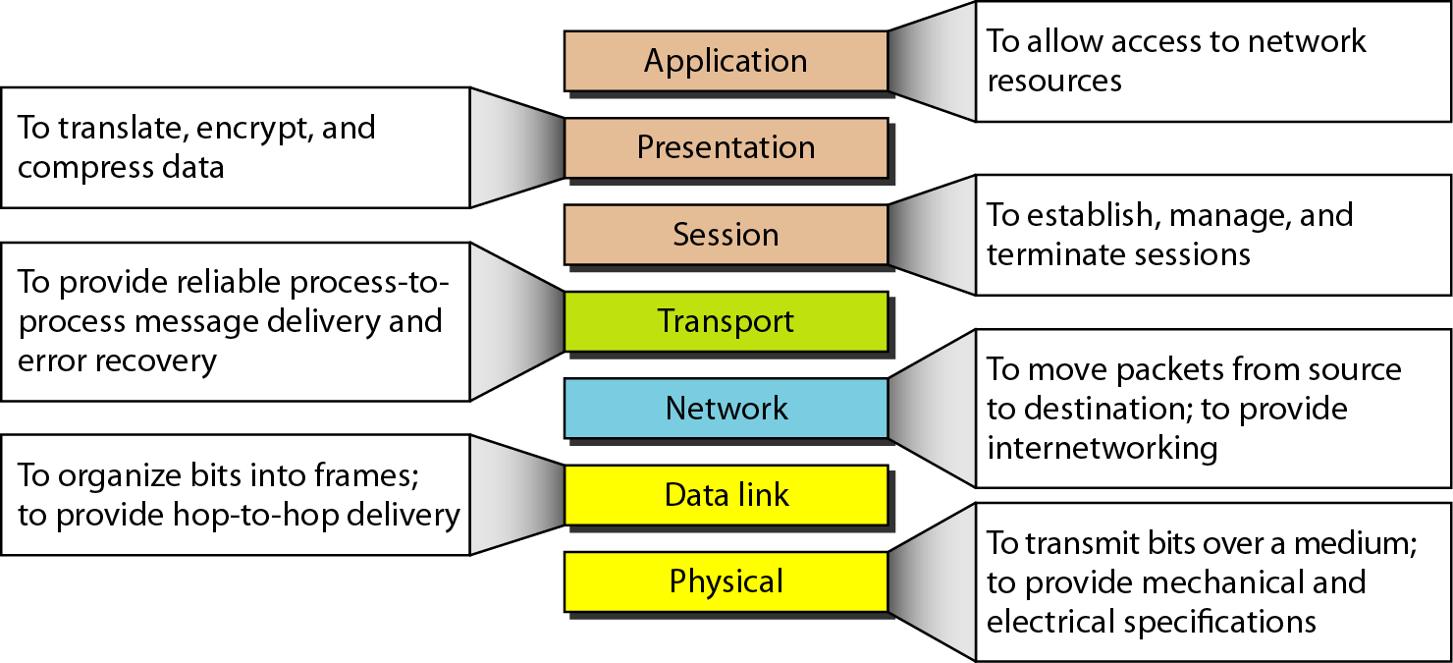
Data Communications ISO OSI reference model (7 layers)

Slide 32
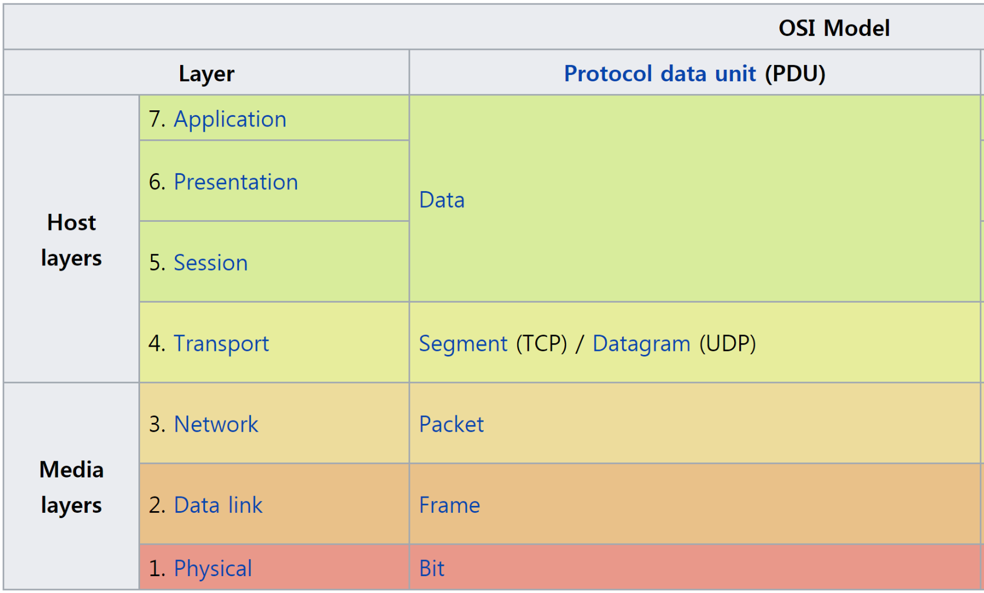
Data Communications Seven layers and Networking protocols
Application dependent,
Presentation
(Network
Security)
Computer
Networks
Data
Communications

Slide 33
Data Communications ISO OSI reference model (7 layers)
Identifiers
Each layer defines two kinds of identifiers
Entity (Object) Identifier
Unique Identifier to distinguish the peer object within the Layer
(IETF) Internet Address (IPv4 and IPv6 addresses)
Identifier for Multiplexing (Service Access Point (SAP) Identifiers)
(Usually unique) Identifier to distinguish the object at the upper layer
LLC Protocol Discrimination (LPD),
IEEE 802 (and/or ISO/IEC) defines.
0xAA/0xAB : SNAP (Subnetwork Access Protocol)
Ethertype Protocol Discrimination (EPD)
Ethertype (IETF)
0x0800 (Internet Protocol Version 4)

Slide 34
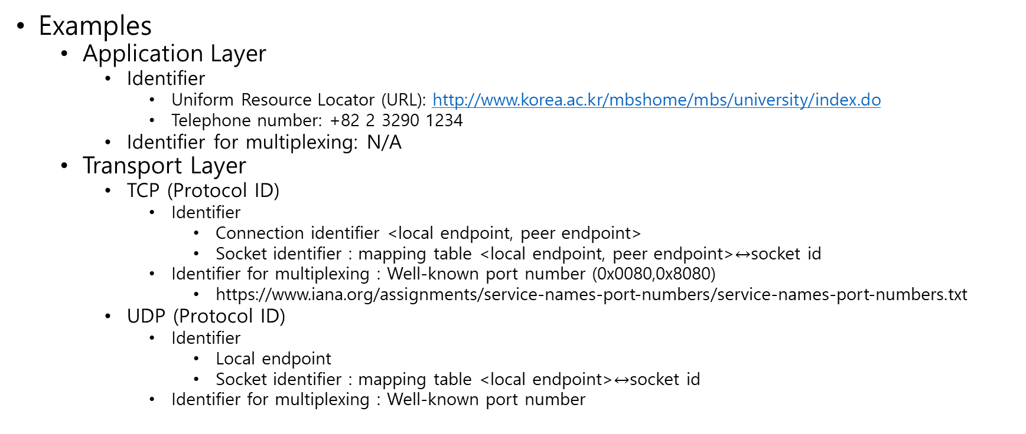
Data Communications ISO OSI reference model (7 layers)
Examples
Application Layer
Identifier
Uniform Resource Locator (URL): http://www.korea.ac.kr/mbshome/mbs/university/index.do
Telephone number: +82 2 3290 1234
Identifier for multiplexing: N/A
Transport Layer
TCP (Protocol ID)
Identifier
Connection identifier <local endpoint, peer endpoint>
Socket identifier : mapping table <local endpoint, peer endpoint>$↔$socket id
Identifier for multiplexing : Well-known port number (0x0080,0x8080)
https://www.iana.org/assignments/service-names-port-numbers/service-names-port-numbers.txt
UDP (Protocol ID)
Identifier
Local endpoint
Socket identifier : mapping table <local endpoint>$↔$socket id
Identifier for multiplexing : Well-known port number

Slide 35
Data Communications ISO OSI reference model (7 layers)
Examples
IP (IPv4/IPv6)
Identifier
Address Family (AF_INET, AF_INET6)
IP address (IPv4 address, IPv6 Address)
Individual address (Unicast address) and Group address (multicast address)
Identifier for multiplexing : protocol number
https://www.iana.org/assignments/protocol-numbers/protocol-numbers.xhtml
IEEE 802.3/11/15.4 (Ethernet, WLAN, WSN)
Identifier
Extended Unique Identifier (EUI-48); MAC-48
Extended Unique Identifier (EUI-64)
Identifier for multiplexing :
Ethertype (2octets) : IEEE 802.3 Ethernet Frame
LLC Address (1octet): IEEE 802.11 with SNMP (Protocol Identifier (5octets): OUI (3octets)+Ethertype(2octets))
https://www.iana.org/assignments/ieee-802-numbers/ieee-802-numbers.xhtml

Slide 36
Data Communications Physical layer
The physical layer defines the electrical and physical specifications of the data connection.
It defines the relationship between a device and a physical transmission medium
the layout of pins, voltages, line impedance, cable specifications, signal timing
similar characteristics for connected devices and frequency (5 GHz or 2.4 GHz etc.) for wireless devices.

Slide 37
Data Communications Physical layer
It may define transmission mode as simplex, half duplex, and full duplex.
It defines the network topology as bus, ring, or star being some of the most common.

Slide 38
Data Communications Ethernet Physical layers names
10, 100, 1000, 10G
the nominal, usable speed at the top of the physical layer
BASE, BROAD, PASS
baseband, broadband, or passband signaling
-T, -S, -L, -C, -K, -F...
medium
T = twisted pair,
F = fiber, various wavelengths
S = 850 nm short wavelength (multi-mode fiber),
L = 1300 nm long wavelength (mostly single-mode fiber)
X, R
PCS encoding method (varying with the generation)
X for 8b/10b block encoding (4B5B for Fast Ethernet),
R for large block encoding (64b/66b)
1, 2, 4, 10
LAN PHYs: number of lanes used per link
Baseband
near-zero frequency range
Broadband
the wide range of frequencies
Passband
the range of frequencies or wavelengths that can pass through a filter
PCS (Physical Coding Sublayer)

Slide 39
Data Communications Physical layer : Ethernet Example
100BASE-TX
4B5B MLT-3 coded signaling
MLT-3 = { +1V, 0V, -1V }
Category 5 cable copper cabling with two twisted pairs
The 8P8C (8 position 8 contact) modular connector
RJ45 after a telephone industry standard
Connectors are frequently terminated using the T568A or T568B assignments that are defined in TIA/EIA-568

Slide 40
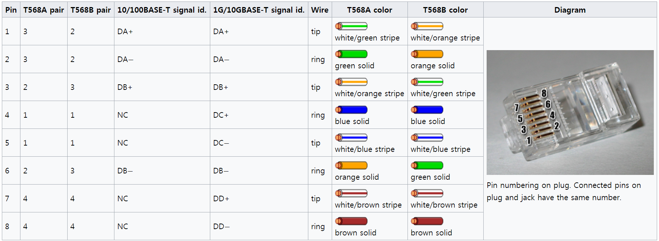
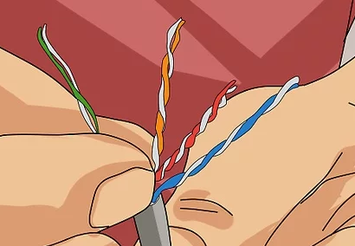
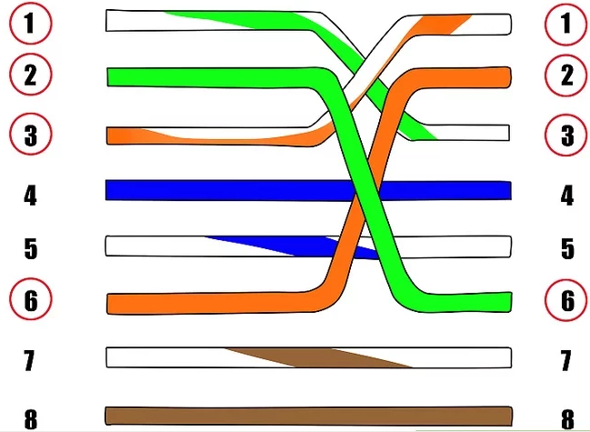
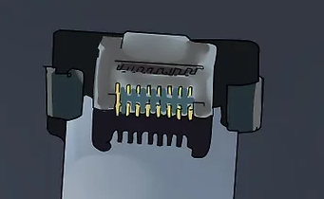

Data Communications Physical layer : Ethernet Example

Slide 41
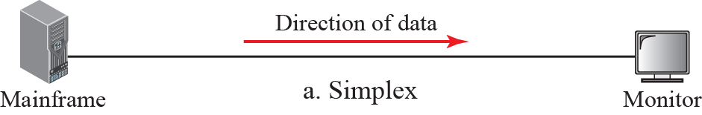
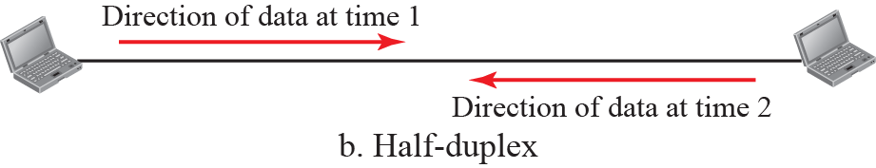
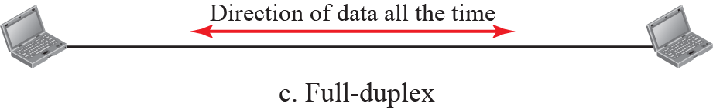
Data Communications Physical layer : Transmission Model

Slide 42
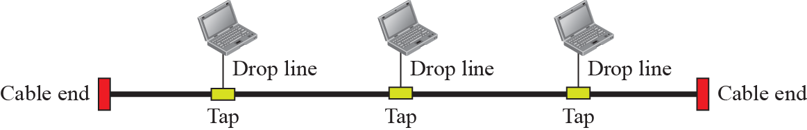
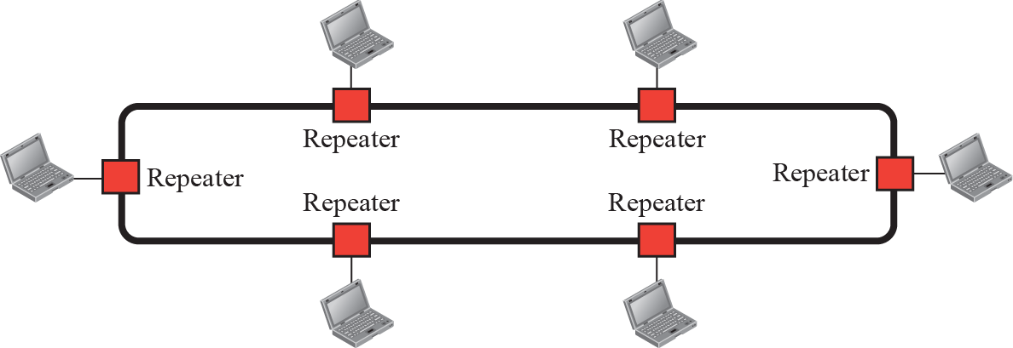
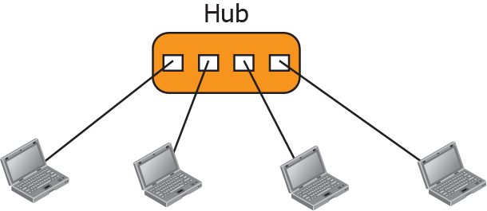
Data Communications Physical layer : network topology
BUS
RING
STAR

Slide 43
Data Communications Data Link Layer
The data link layer provides node-to-node data transfer using a link between two nodes which are directly connected to the link.
The link is a conceptual link.
It can be a physical medium.
It can be a logical link established by using more complex protocols

Slide 44
Data Communications Standards for Physical / Data Link Layer
Standards for logical link
High-Level Data Link Control (HDLC)
(ISO 13239) a bit-oriented code-transparent data link layer protocol
Point-to-point Protocol (PPP)
(RFC1661) a data link layer communications protocol used to establish a direct connection between two nodes
(RFC1662) PPP in HDLC-like Framing
IP in IP Tunneling (or IP Encapsulation within IP)
(rfc1853) IP in IP Tunneling
(RFC2003) IP Encapsulation within IP
STP (Signal Transfer Point)
(3GPP TS 29.016 V4.1.0 (2002-06))

Slide 45
Data Communications Data Link Layer
The link at the data link layer must define frames for control, management, and data transfer between two nodes which are connected to the link
It defines the protocol to establish and terminate a connection between two physically connected devices.
It detects and possibly corrects errors that may occur during transferring frames using the link.
It also defines the protocol for flow control between them

Slide 46
Data Communications Standards for Physical / Data Link Layer
IEEE 802.3 ETHERNET
802.3
1G/5G/10G/25G/100G/400G
802.3bp-2016 1000BASE-T1
Gigabit Ethernet over a single twisted pair, automotive & industrial environments
IEEE 802.11 Wireless LAN
802.11
2M/11M(11b)/54M(11g)-2.4Ghz-20Mhz
54M(11a)-5GHz-20Mhz
150M(11n)-2.4/5GHz-40Mhz
866M(11ac)-2.4/5Ghz-160Mhz (single Spatial stream) (WiFi5)
1.2G(11ax)-2.4/5GHz-160Mhz- ((single Spatial stream) 6Extension- higher than 6Ghz
6.7G(11ad)-60GHz-2160Mhz
802.11p for VANET (WAVE:US & C-ITS: Europe)
5.85-5.925 GHz-10MHz x 7 channels
802.11ah for IoT (radius: up to 1km)
800Mhz (Europe) or 900Mhz (USA), 1-16Mhz, 300kbps-86.7Mbps (single Spatial stream)
IEEE 802.15.4 Wireless Sensor Network (IoT)

Slide 47
Data Communications Network Types
The criteria of distinguishing one type of network from another is difficult and sometimes confusing
size,
geographical coverage, and
ownership

Slide 48
Data Communications Network Types
A local area network (LAN) is usually owned by the same organization that owns attached devices
Smaller scope, typically a single building
Internal data rates greater than WANs
Most common configurations are switched LANs and wireless LANs

Slide 49
Data Communications Network Types
A wide area network (WAN) has a wider geographical span, spanning a town, a state, a country, or even the world
a WAN interconnects connecting devices such as switches, routers, or modems
a WAN is normally created and run by communication companies and leased by an organization that uses it
Requiring the crossing of public right-of-ways

Slide 50
Data Communications Network Types
A Metropolitan Area Network (MAN) provides a middle ground between LANs and WANs, typically spanning a town, city, suburb or metro area with higher speed connections
Private or public network

Slide 51
IEEE 802 Reference Model
Informational
Nested Layering - Sublayers

Slide 52
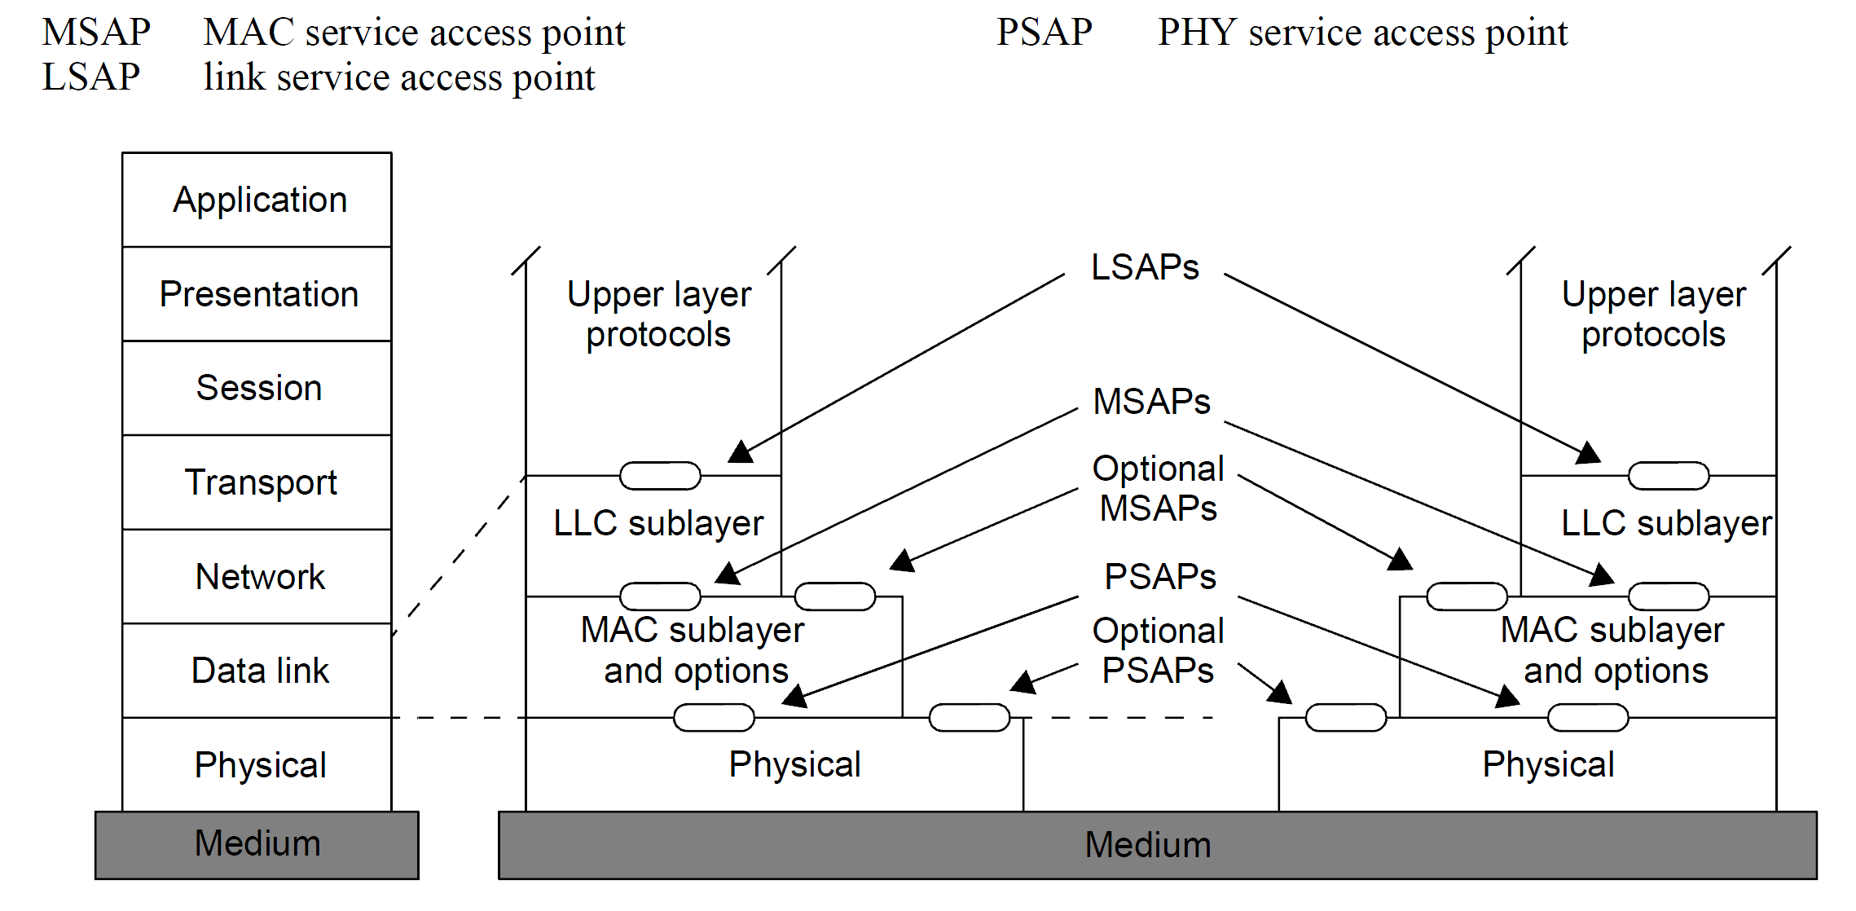
Physical Layer IEEE 802-2014 Reference models

Slide 53
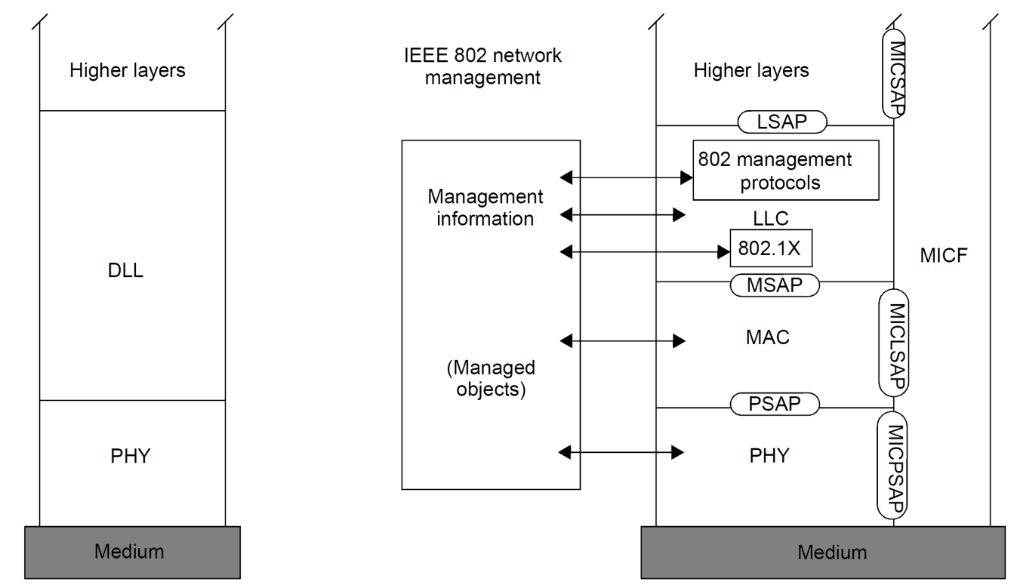
Physical Layer IEEE 802-2014 Reference models
DLL data link layer
PHY physical layer (OSI reference model and IEEE 802® RM)
LSAP link service access point
MSAP MAC service access point
PSAP physical service access point
MIB management information base
MICF media-independent control function
MICLSAP media-independent control link service access point
MICPSAP media-independent control physical service access point
MICSAP media-independent control service access point
MIH media-independent handover
MIHF media-independent handover function
IEEE Standard for Local and Metropolitan Area Networks: Overview and Architecture

Slide 54
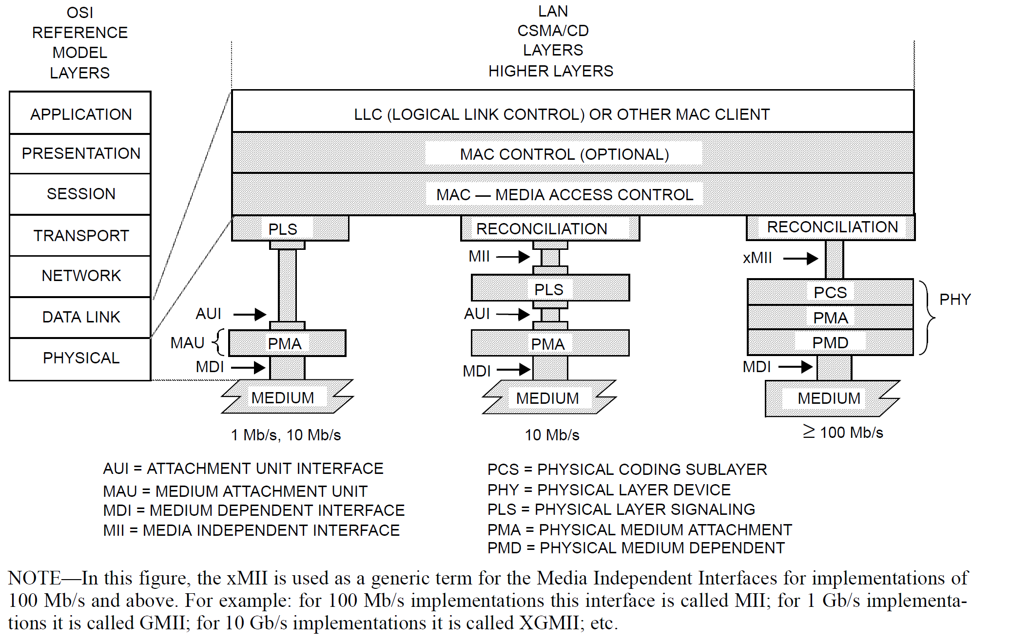
Physical Layer IEEE 802.3 Ethernet Example
IEEE Std 802.3-2008 CSMA/CD

Slide 55
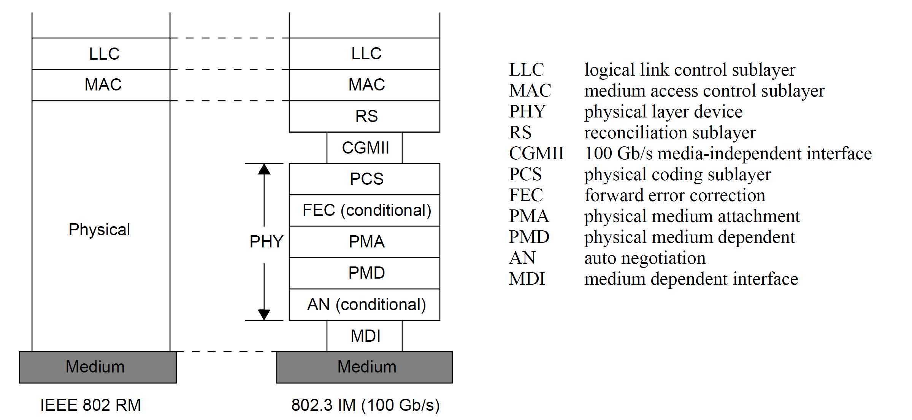
Physical Layer IEEE 802.3 Ethernet Example
IEEE Std 802-2014 OVERVIEW AND ARCHITECTURE
an example of an end-station implementation model (UM) (100 Gb/s)

Slide 56
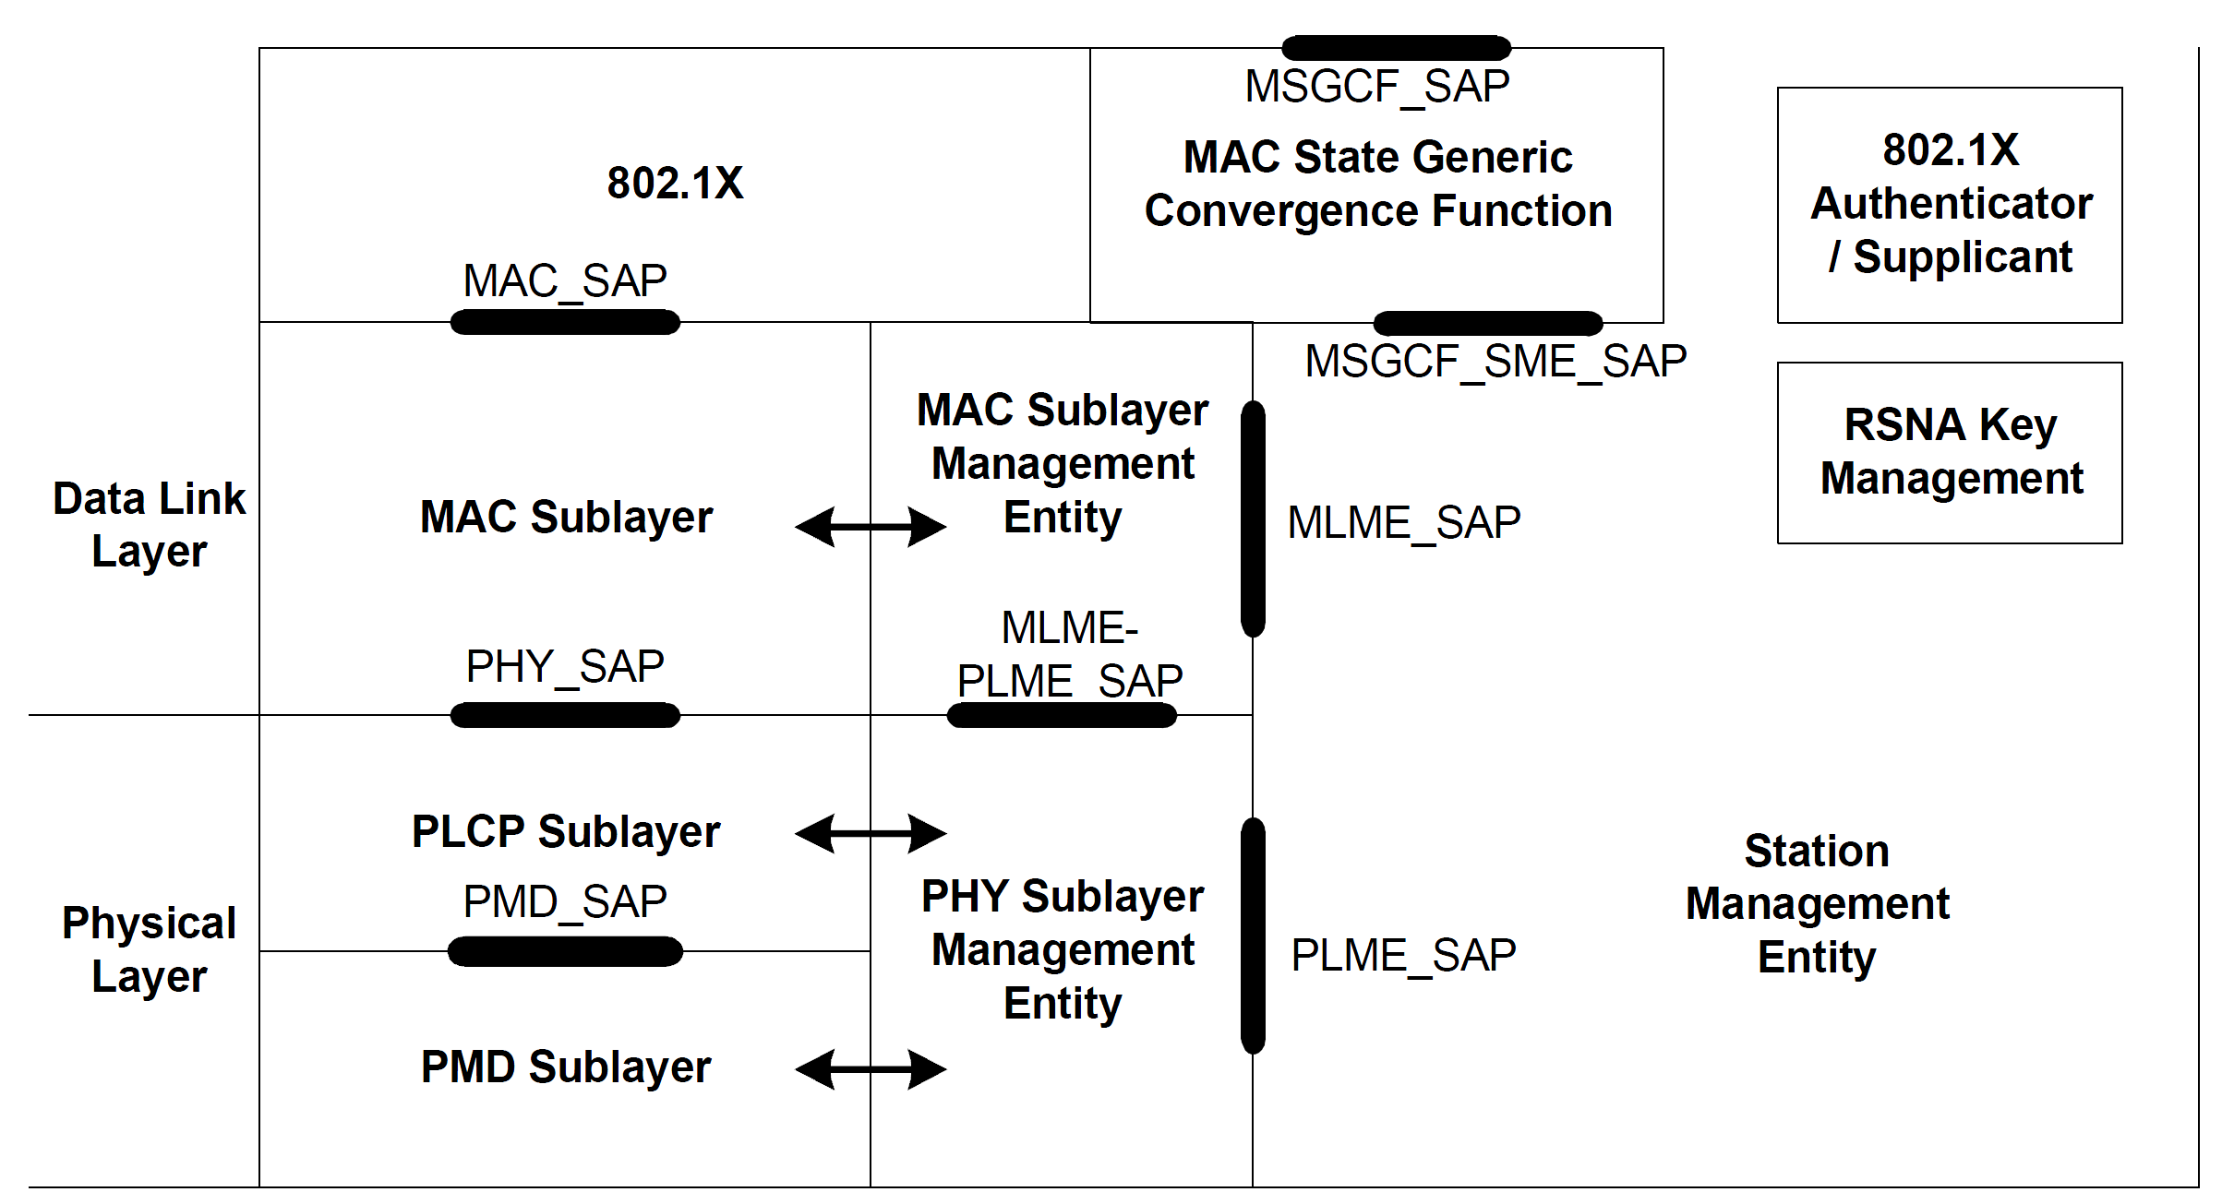
Physical Layer IEEE 802.11-2020 WLAN Example
IEEE Std 802.11-2012 WIRELESS LAN MAC AND PHY SPECIFICATIONS

